Slide 1
Covid-19 India Data Visualization
By
Ganeshkumar Patil
E.No: 51434827

Slide 2
Abstract
Dataset contains states wise and nationwide information.
Before processing data, need to fix missing values from dataset.
Numerical values such as infection trend or population can be shown on graphs.
Categorical values such as persons details or testing lab address are need to be shown in table form.
Priorized data like total number of items like total infections or hospital bed information can also be shown on table format.

Slide 3
Data and Pre-processing
Data set contains overall and statewise information.
Need to extract overall india information first.
Fill missing information with previous dated information in that specific column of dataset.
Continuous numerical data can be shown using graphical view.
Categorical data can be shown using table format.
Similar approach can be used for statewise data from dataset.

Slide 4
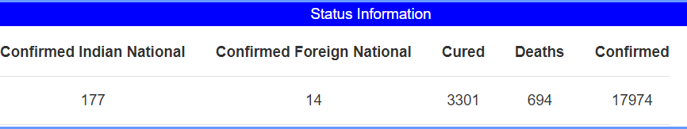
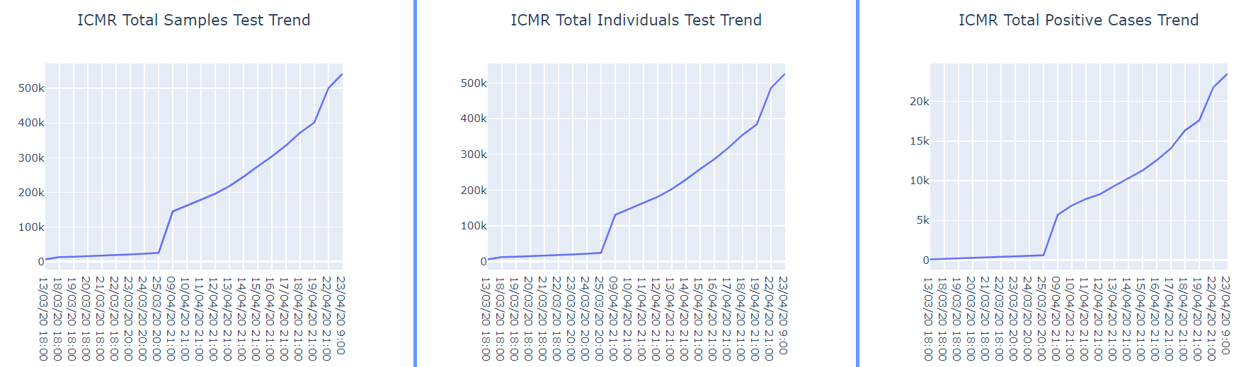
Data Story-1 (India Overall)
“Overall” tab provides nationwide information. It default tab when opened main page.
Overall india infection status information can be shown on table.
Overall hospital bed information are shown on table format as below:
ICMR test information like total samples, positive/negative cases trend can be seen on individual interactive graphs.

Slide 5
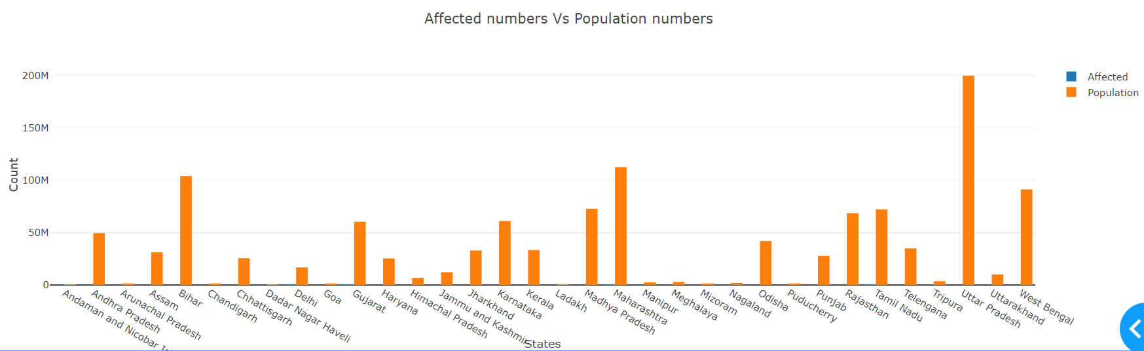
Data Story-2 (India Overall)
Total population of each state vs infected people count are compared as below. Since infected people count is very less compared with overall population of the state, infection count bar is not visible in below graph.

Slide 6
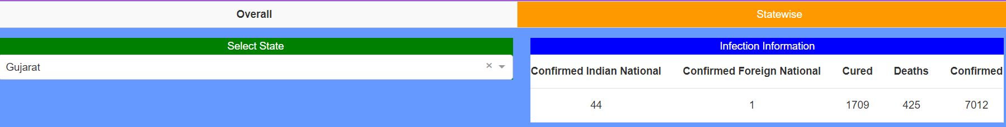
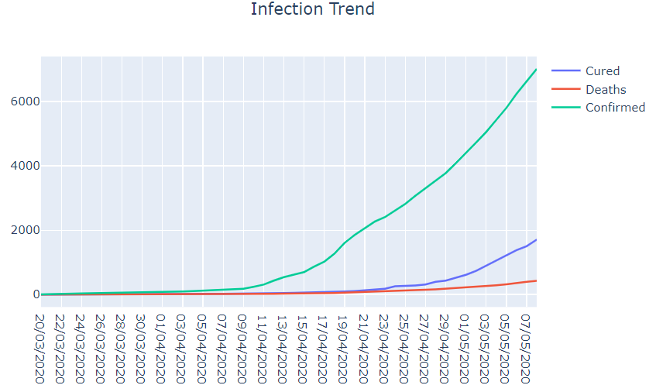
Data Story-3 (State wise)
“Statewise” tab provides option to select state to get information.
State selection and infection status table information is shown as below:
Hospital bed information is shown on table format:
Infection trend is shown in
interactive graph:

Slide 7
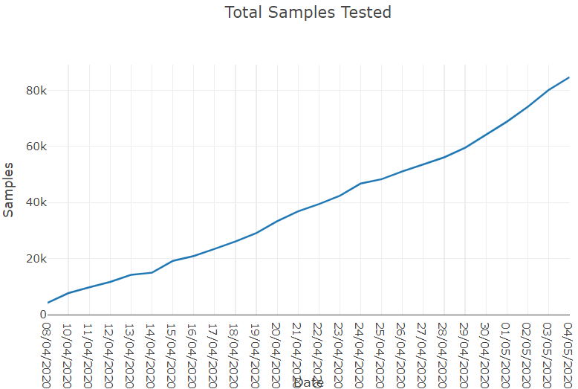
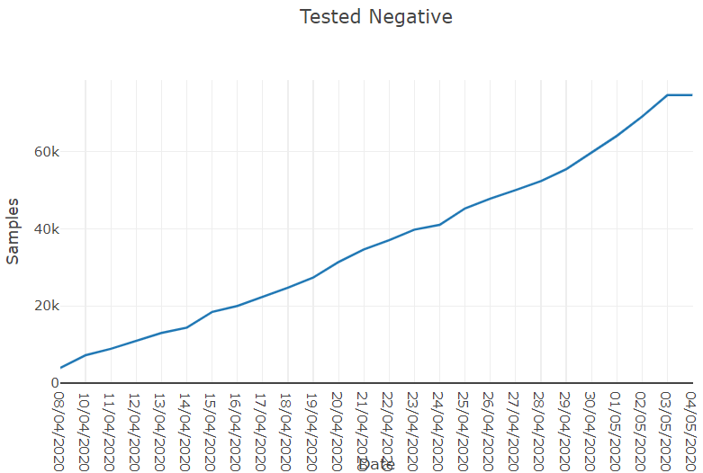
Data Story-4 (State wise)
Total sample tested trend is
shown as below:
Total negative cases trend is
shown as below:

Slide 8
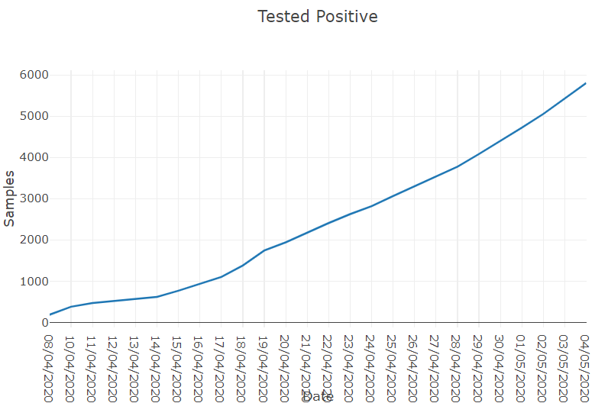
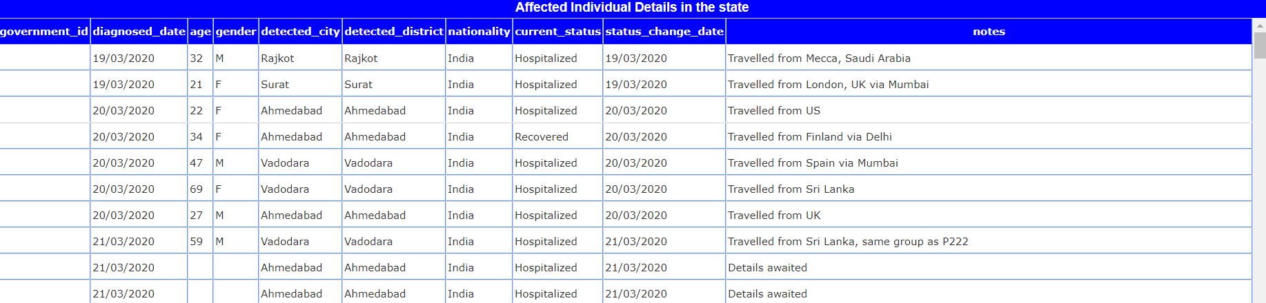
Data Story-5 (State wise)
Total Positive cases trend is
shown as below:
Affected Individual details in the state is showed on table format:

Slide 9
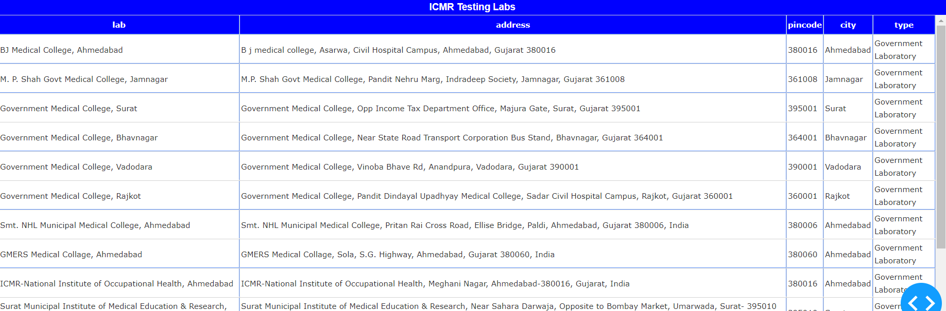
Data Story-6 (State wise)
ICMR Testing lab information is shown as below:

Slide 10
Techniques Used
This dashboard is developed using python.
Plot.ly is company developed plotly and dash in python, Javascript and R languages.
I opted python to develop dashboard.
Plot.ly also developed dash module which can be used to develop dashboard with less code and pure python.
Dash module provides html and dash core components to develop dashboard.
It also provide interactive graphical features and web framework to develop dashboards.
Used python pandas module to process data from csv files.
Pandas provides flexible functions to process data such as filling missing values and data operations.

Slide 11
END

